Slide 1
New Jersey Department of Environmental Protection
Transportation Oversight Unit
Bob Gomez, Supervisor
Ron Feehan, Lawrence Lewis, Chris Farrar
& Mike Kosierowski
9 Ewing Street, Mail Code 09-01
P.O. Box 420
Trenton, New Jersey 08625-0420
(609) 292-6305

Slide 2
Responsibilities Of TOU
Solid, Hazardous & Medical Waste Transporter Compliance
10-Day HW Transfer Facility Inspections
Load consolidation, check DOT markings, packaging & compatibility
Record keeping – log books, (DOT & RCRA requirements) hazardous waste manifests (shipping descriptions & emergency contact #)
Vehicle Compliance Inspections
Generator locations where waste is offered for transport
Roadside with NJSP
10-Day HW Transfer Facilities
Disposal Facilities

Slide 3
Selecting A Transporter
Do I use a waste broker or find my own transporter?
Brokers & transporters require an A-901 license (HW & SW)
Solid waste transporters & brokers also require CPCN
HW & SW transporters are also required to be registered with DEP to transport the type of waste they are transporting and are issued decals to place on their equipment

Slide 4
Selecting A Transporter
Reputable transporter or broker checklist:
Always ask for copy of A-901 & CPCN (for SW)
Is equipment displaying current decals (look at equipment)
Check DOT Safer site to make sure the transporter has not been revoked by DOT & to check compliance & safety ratings
Check NJ DEP’s Data Miner to evaluate compliance history

Slide 5
Various Types of DEP Decals

Slide 6
A-901 License & CPCN Examples

Slide 7
DOT Requirements Applicable to Hazardous Waste Generator’s
Comply with training requirements
Properly identify waste being shipped
Select an authorized package
Properly mark the package
EPA & DOT marking requirements
Complete the shipping paper (HW Manifest)
Comply with placarding requirements

Slide 8
DOT Requirements Applicable to Hazardous Waste Generator’s
Training (49 CFR 172.704)
Hazmat employers must provide training to their hazmat employees & shall include:
General awareness training - enabling the employee to recognize & identify hazardous materials

Slide 9
DOT Requirements Applicable to Hazardous Waste Generator’s
Training 172.704 - cont.
Function Specific – hazmat employee must receive specific training to the hazmat function(s) performed
Safety training – shall include emergency response information, methods of avoiding accidents such as proper handling procedures, & measures to protect themselves from exposure

Slide 10
DOT Requirements Applicable to Hazardous Waste Generator’s
Training 172.704 - cont.
Security awareness & In-depth security training
Refer to Subpart I (172.800 & 172.804) for security plan specifics
Initial & recurrent training
Initial completed within 90 days of hire or change in function, may work under direct supervision of knowledgeable hazmat employee until training is completed
Recurrent must be done at least every 3 years
Relevant training received from a previous employer or other
source is also acceptable
Notes:
Security Awareness must be provided to all hazmat employees - it must include:
-- awareness of security risks associated with hazmat transportation
--methods designed to enhance transportation security
--it must also include a component covering how to recognize & respond to possible security threats.

Slide 11
DOT Requirements Applicable to Hazardous Waste Generator’s
Training 172.704 - cont.
Training Records Must Include:
Hazmat employee's name
Completion date of most recent training
Training Materials (Copy, description, or location)
Name and address of hazmat trainer
Certification that the hazmat employee has been trained and tested
Notes:
Security Awareness must be provided to all hazmat employees - it must include:
-- awareness of security risks associated with hazmat transportation
--methods designed to enhance transportation security
--it must also include a component covering how to recognize & respond to possible security threats.

Slide 12
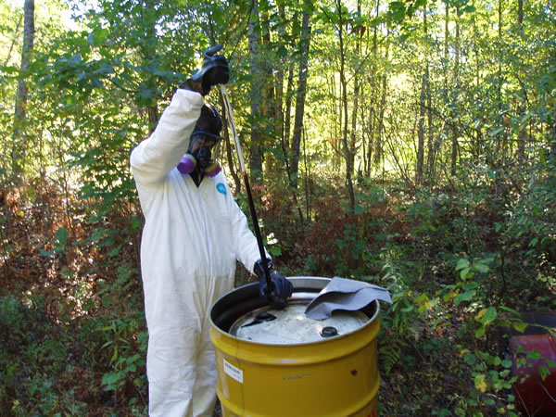
Identify Your Waste
Generator knowledge (MSDS, prior analytical)
Testing of waste material
EPA & DOT have very detailed testing methodology protocols

Slide 13
Examples of Basic Descriptions
Acetone, 3, UN1090, PGII
Phosphoric acid solution, 8, UN1805, PGIII
On January 1, 2013, the sequence was altered to
match the international sequence:
1. UN ID number
2. Proper shipping name
3. Hazard class
4. Packing group
Now the basic description for these chemicals
is:
UN1090, Acetone, 3, PGII
UN1805, Phosphoric acid solution, 8, PGIII

Slide 14
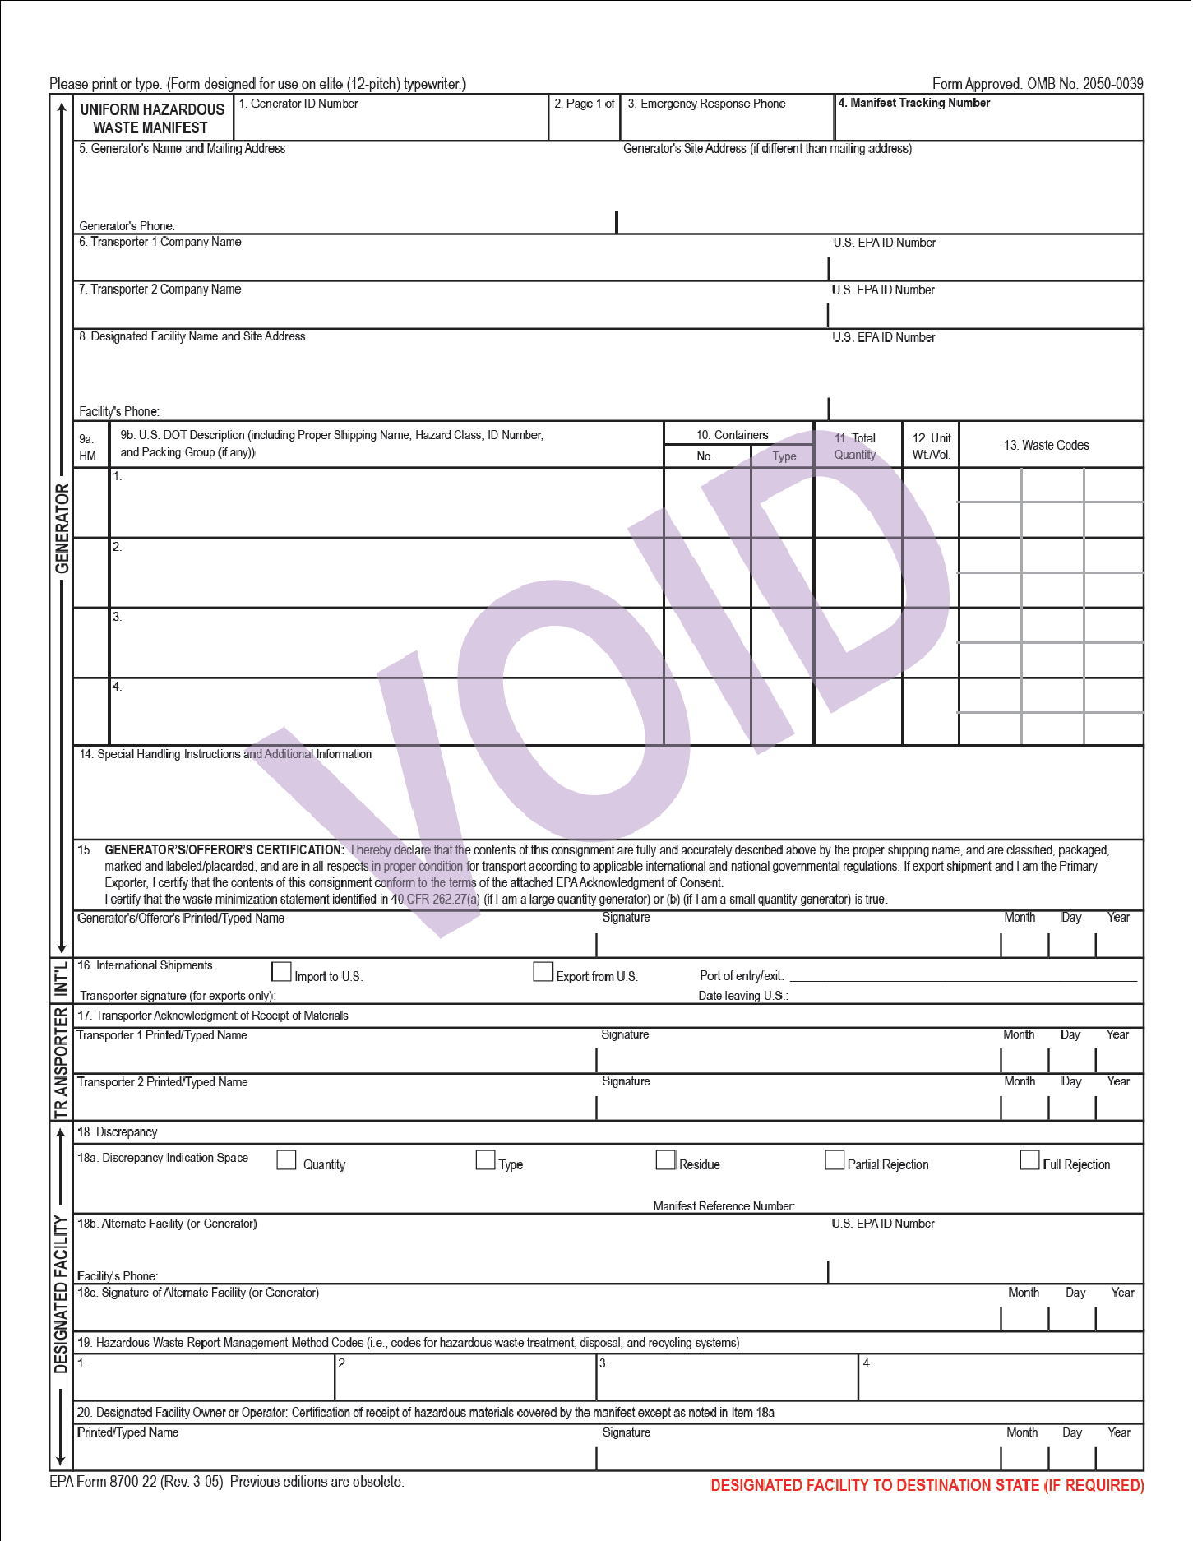
Shipping Paper – HW Manifest

Slide 15
Uniform Hazardous Waste Manifest is the Shipping Paper For Hazardous Waste
Select basic shipping description from the 172.101 Table by:
Selecting proper shipping name (PSN)
Hazard Class
ID number
Packing Group
Total quantity being shipped
If the PSN does not include the word “waste” & hazardous waste is being shipped the word waste must precede the proper shipping name

Slide 16
Uniform Hazardous Waste Manifest is the Shipping Paper For Hazardous Waste
Shipping Paper Cont.
Provide Emergency Response Information
(E.R.G. # or MSDS form)
Emergency Response Telephone number, see 172.604
Monitored at all times the material is in transportation (until it is accepted at TSD)
Person must have knowledge of material being shipped & have comprehensive ER information of the material or immediate access to someone who has this knowledge.

Slide 17
Uniform Hazardous Waste Manifest is the Shipping Paper For Hazardous Waste
Shipping Paper Cont.
Generator Certification 172.204
By signing the manifest the generator is certifying the consignment is fully & accurately described by the proper shipping name, classified, packaged, marked, labeled, & in all respects in proper condition for transport...

Slide 18
DOT Requirements Applicable to Hazardous Waste Generator’s
General Non-Bulk Marking Requirements 172.301
For hazardous waste EPA marking required at 40 CFR 262.32 must be on package & include:
Generator’s name & address, manifest document #, proper shipping description, technical names, special permit #
Other prescribed DOT markings shall be used, where required, such as package orientation arrows for liquids, inhalation hazard, marine pollutant for vessel transportation (where applicable), or Biohazard

Slide 19
DOT Non Bulk Package Marking
DOT Hazard Warning Labels:
Same surface of package and near PSN
Primary & subsidiary labels, when required, must be next to each other (within 6 inches of each other)

Slide 20
DOT Non Bulk Package Markings
Types of Markings:
EPA Marking
DOT Hazard Warning Labels
Package Orientation Arrows
Notes:
Non bulk packages have a max. cap. Less than:
- For Liquids <119 gallons (450 liters)
- For Solids <882 pounds (400 kilograms)
- For Gas <1,000 pounds (454 kilograms)
Bulk packages anything greater than non-bulk quantity.

Slide 21
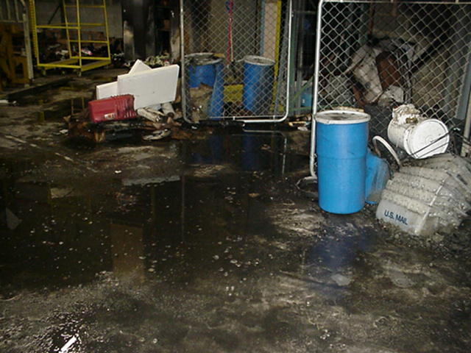
Improper Packaging
Result of lithium
batteries that were not
packaged properly

Slide 22
Properly Packaged & In Proper Condition for Transportation?

Slide 23
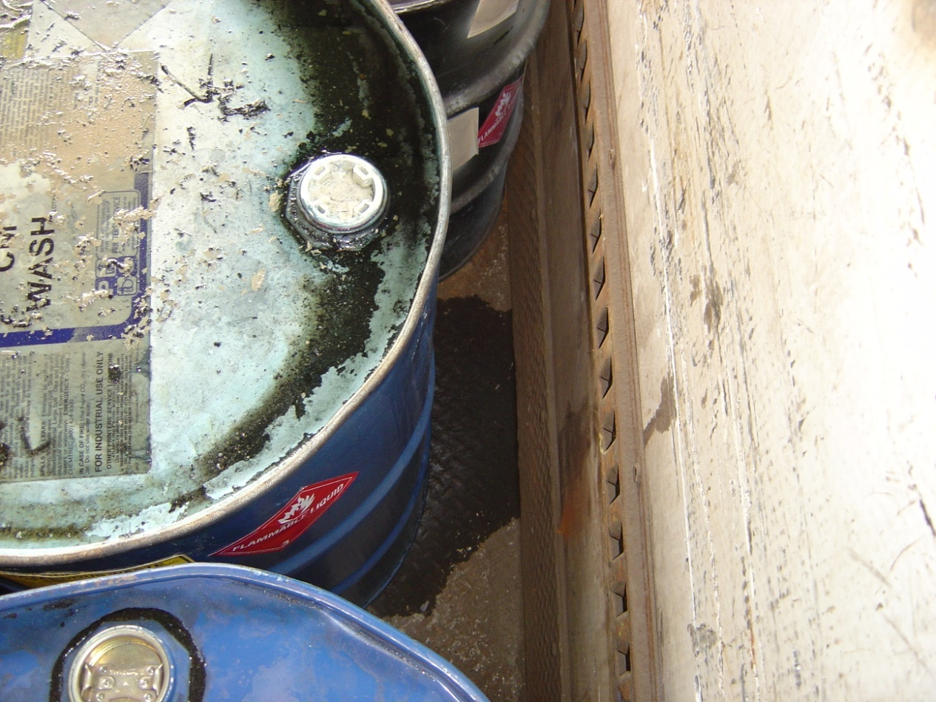
Properly Packaged & In Proper Condition for Transportation?
Must make sure package is closed in accordance with closure instructions
In this case a plastic bung was used in place of a metal one

Slide 24
Properly Packaged & In Proper Condition for Transportation?
Bung was not tightened
Does not meet the minimum packaging standard at 49 CFR 173.24

Slide 25
Placarding
General rules:
Must appear on all four faces of the tractor/trailer
Required for:
Bulk packaging regardless of quantity
Table 1 – Any quantity
Table 2 – Equals or exceeds 1001 lbs. or 454 Kg in non-bulk packaging or any quantity in bulk packaging
Joint responsibility of shipper and carrier
49 CFR 172.500

Slide 26
Placarding
Notes:
Non bulk ID marking
- when 4,000 kg (8,820 lbs.) or more is picked up at an individual location
Bulk package ID# marking
- all 4 sides for packages with >1,000 cap. Or more
- on 2 opposing sides for bulk packages <1,000 gal. Cap.

Slide 27
DOT Requirements Applicable to Hazardous Waste Generator’s
Labeling Requirements - Subpart E
Label(s) selection, Column 6 of 172.101 Table
Label placement on package 172.406
Same surface of package and near PSN
Primary & subsidiary labels, when required, must be next to each other (within 6 inches of each other)
As of 10/1/05, all subsidiary labels must contain a hazard class or division number in the lower corner

Slide 28
DOT Requirements Applicable to Hazardous Waste Generator’s
Placarding Requirements - Subpart F
Placard selection, Column 3 of 172.101 Table
Generator’s responsibility 172.506
Each person offering a motor carrier a hazardous material for transportation by highway shall provide to the motor carrier the required placards for the material being offered prior to or at the same time the material is offered for transportation, unless the carrier’s motor vehicle is already placarded for the material as required by this subpart

Slide 29
DEP Vehicle Marking Requirements

Slide 30
Helpful Web Links
US DOT Pipeline & Hazardous Materials Safety Administration
http://www.phmsa.dot.gov/hazmat
Regulations
Interpretations
Training resources
Regional DOT contact information
US DOT Hazardous Materials Information Center
800-467-4922 or phmsa.hm-infocenter@dot.gov
US DOT Federal Motor Carrier Safety Administration
https://safer.fmcsa.dot.gov/CompanySnapshot.aspx
Quick look at compliance & safety ratings of a transporter

Slide 31
Helpful Web Links
NJ DEP Transporter Registration Page
http://www.nj.gov/dep/dshw/hwr/regislic/lru.htm
Go to drop down menu and select type of transporter you are looking for:
Report – Solid Waste Transporters (A-901 Licensed)
Hazardous Waste Transporters (A-901 Licensed)
Medical Waste Transporters
NJ DEP Transporter Compliance History via Data Miner
http://www.nj.gov/dep/opra/online.html
Click on blue button on right “click here to launch DEP Data Miner”
Search by name of transporter. For questions navigating Data Miner contact Liz Hennessey at (609) 292-6305 or elizabeth.hennessey@dep.nj.gov

Slide 32
TOU Contacts & Areas of Knowledge
Bob Gomez, Supervisor (609) 292-3837 robert.gomez@dep.nj.gov
Areas of knowledge: RCRA, DOT, A-901 and Solid & Hazardous Waste Transportation
Ron Feehan, Investigator (609) 292-3853 ron.feehan@dep.nj.gov
Areas of knowledge: Solid Waste Transportation, A-901 and Utility Regulations
Mike Kosierowski, Env. Specialist 3 (609) 439-9640 michael.kosierowski@dep.nj.gov
Areas of knowledge: RCRA, DOT and Solid & Hazardous Waste Transportation
Lawrence Lewis, Env. Specialist 2 (609) 209-1762 lawrence.lewis@dep.nj.gov
Areas of knowledge: Solid, Hazardous and Medical Waste Transportation
Chris Farrar, Env. Specialist 1 (609) 439-8217 chris.farrar@dep.nj.gov
Area of knowledge: Solid Waste Transportation

